Slide 1
Geog 312 Assignment 4
Analysis of Variance (ANOVA)
Joseph Moore, Jimmy Barnett, Maximiliano Arguindegui
Group ID 908647

Slide 2
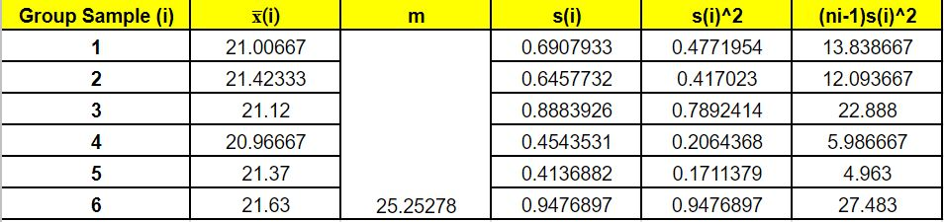
Grass Surface Temperature Statistics

Slide 3

ANOVA + null hypothesis
The null hypothesis for this assignment states that any differences in our sample means can be explained by the random variability of our samples. Since the F value is so low, it is safe to accept our null hypothesis. Since all of the data was collected on the same day, at the same time, and in the same general area (near Psych building and academic plaza), it makes sense that the mean values for all groups are the same, and that the only differences are very slight, and can be attributed to random variability.

Slide 4
Part 4
After running an ANOVA analysis of the three surface temperatures, we found that the null hypothesis was validated and there is a statistically significant difference between temperatures on the three different surfaces observed. After running the ANOVA analysis we ended up with a residual standard error of 1.146633.

Slide 5
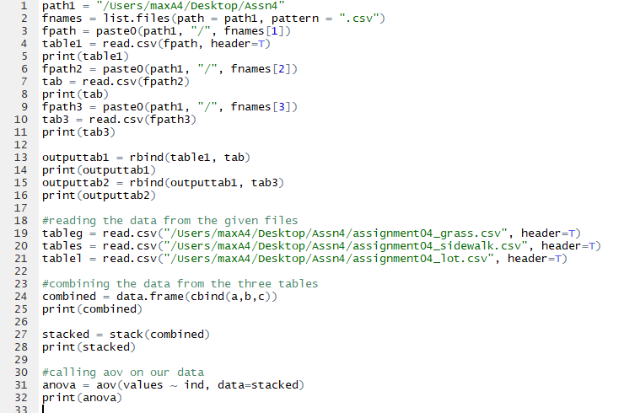
R code
Number 4 code.

